Slide 1

Coping with Challenges Through Sustainable Development
The Gulf Petrochemical Industries
Dr Mohammed Yousef Al Mulla
23 November 2009

Slide 2
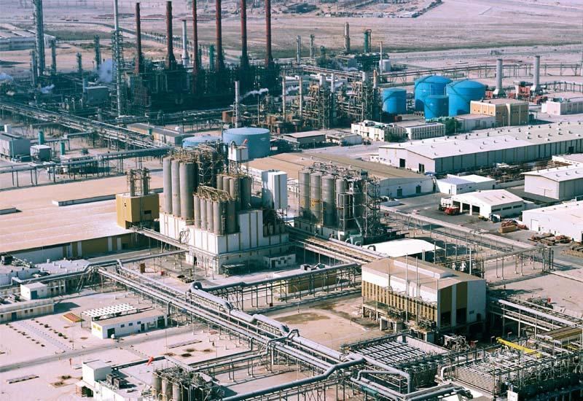
AGENDA
The Region's Petrochemical Success Factors
Operations
Marketing & Logistics
The Environment
Human Resources
Information Technology
Finance
Conclusion

Slide 3
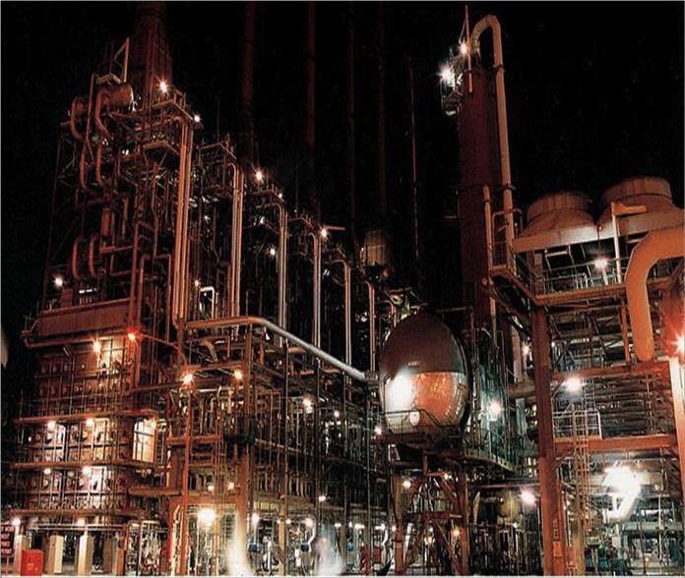
AGENDA
The Region's Success Factors & Challenges
Operations
Marketing & Logistics
The Environment
Human Resources
Information Technology
Finance
Conclusion

Slide 4
I. The Region's Petrochemical Success
….Attributed to many factors:
The relative advantage of competitive feedstock cost
Competitive labor cost
Well developed infrastructure and support
Fiscal incentives, exemptions and taxes
Government support through policies and legislation
Geographic advantageous positioning in targeting, Asian, African and European Markets
Economy of Scale benefits due to large projects with much lower operating & capital costs compared to much smaller scale existing projects in the western world

Slide 5
II. The Major Challenges are
  New Companies are Appearing, Expanding Rapidly and New Mergers/ Acquisitions are Taking Place
  Long-established Western Companies are Exiting, Shrinking, or Moving East, Often in Partnerships, Trying to Defend Their Stakes
  New Technologies May Transform the Industry Further
  Finance, and HR

Slide 6
Agenda
The Region's Petrochemical Success Factors
Operations
Marketing & Logistics
The Environment
Human Resources
Information Technology
Finance
Conclusion

Slide 7
First ==➔ Operations
Upgrading the quality of industrialization in terms of size and flexibility in the GCC countries and equipping them to standup to face the international competition under the emerging global circumstances is very necessary to sustain the development process.
This could be achieved through producing & exporting quality products, enhance productivity & efficiency in operations and cutting production cost so as to attain a higher level of competitiveness. The productivity and efficiency off-course should not be at the cost of safety.
The industry has recognized this fact that its own survival and durability is possible only through integrating its impacts on the planet from all aspects i.e. technological advancement, Safety & Environment, Energy Management, Resources management etc.

Slide 8

Agenda
The Region's Petrochemical Success Factors
Operations
Marketing & Logistics
The Environment
Human Resources
Information Technology
Finance
Conclusion

Slide 9
Second==➔ Marketing & Logistics
The focus should be “customer satisfaction through delivering a quality product at a competitive price with quality service”.
GCC companies should expand along: capacity, portfolio and geography
In order to reach all major markets of the world in a timely manner it is necessary to build a global marketing and supply chain network.
Having manpower, vessels, terminals and marketing personnel around the world to manage the network.
Strategic alliances among the producers and various players of the supply chain with a view to bring down the logistics costs

Slide 10
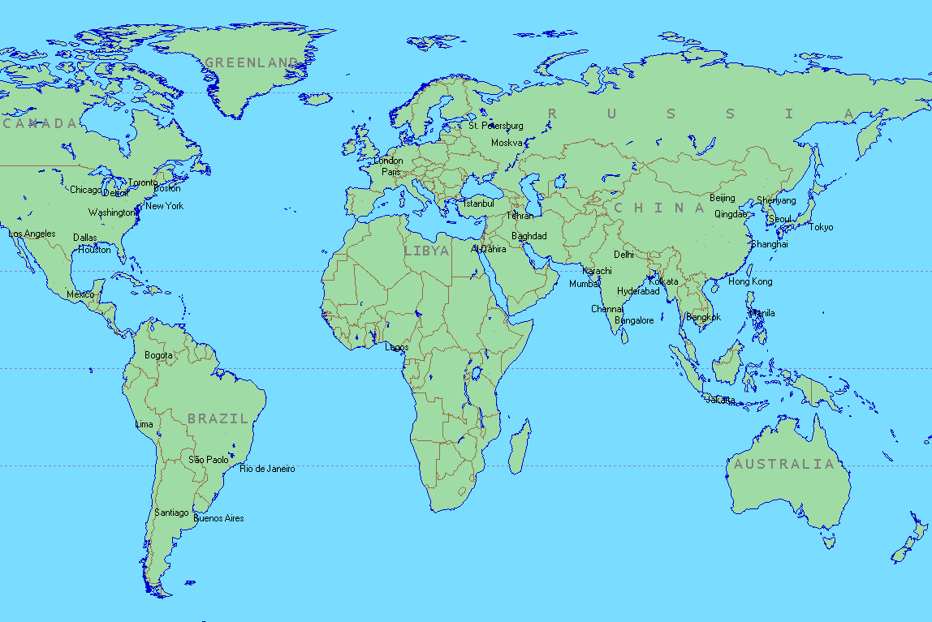
QAPCO “Marketing Network”

Slide 11

Agenda
The Region's Petrochemical Success Factors
Operations
Marketing & Logistics
The Environment
Human Resources
Information Technology
Finance
Conclusion

Slide 12
Third ==➔ The Environment
In future, the World will need vast amounts of extra energy to support economic growth and reduce poverty. Hence, Both Middle East and the global chemical producers have central and expanding roles to play in meeting the energy efficiency and environment challenges.
The industry needs to extend its range of feedstock to focus on energy efficiency and, increasingly, employ carbon capture and storage technologies in order to reduce CO2 emissions.
A combination of energy ,technology and teamwork along the value chain will be essential for long-term sustainable success.

Slide 13
The Environment – cont’
The industry is judged by our peers, consumers, governments and society at large, on our ability to optimize our energy efficiency and minimize our CO2 emissions while delivering products and services that make the world a better and sustainable place to live.
The deployment of new technologies & equipments require huge capital investments, hence It would be extremely useful, if GCC region develops Common Environmental Protection Regulations and develop joint research program in this direction.

Slide 14

Agenda
The Region's Petrochemical Success Factors
Operations
Marketing & Logistics
The Environment
Human Resources
Information Technology
Finance
Conclusion

Slide 15
Fourth==➔ Human Resources
The industry has exceptional human talent, however there is a need for a generation of Engineers, Technologists and Leaders/Managers required to meet the challenges of the future.
We need to secure the right and qualified Human resources to achieve the corporate objectives.
GCC companies must change themselves to a learning organizations to be able to develop knowledge and skills and build innovative manpower.

Slide 16
Human Resources – cont’
We need to recognize this fact that our Manpower whether Nationals or Expatriates, both form the critical part of our privileged assets as they play a central & crucial role in the overall efficiency in operations, which ultimately boost our financial performances.
We should allow our Nationals to attain appropriate qualifications and develop and retain them for career development in the company.
Our objective to replace expatriate manpower with Nationals, should be based on their capabilities provided that the related efficiency of the operation is maintained.

Slide 17

Agenda
The Region's Petrochemical Success Factors
Operations
Marketing & Logistics
The Environment
Human Resources
Information Technology
Finance
Conclusion

Slide 18
Fifth==➔ Information Technology
The information technology is a strategic tool in the hand of Management as a business enabler. It can optimize management of operations, assets, risks, revenue generation and the environment.
Right selection and use of Information Technology allows fast, accurate decision making, control and improve the business processes.
Most of the companies in the Middle East have yet to implement the business intelligence and data warehousing IT solutions.

Slide 19
Information Technology – cont’
The unparallel growth of the Petrochemical industry and increased global competition has lead to heavy investment in IT by the Companies, this has resulted in an increased efficiency, cost reduction and edge over competition.

Slide 20

Agenda
The Region's Petrochemical Success Factors
Operations
Marketing
The Environment
Human Resources
Information Technology
Finance
Conclusion

Slide 21
Sixth==➔Finance
The petrochemical industry is capital intensive industry requiring heavy cash outflows. The availability and adequacy of Finance at a competitive cost in the region is very important for its sustainability.
The petrochemical projects like Olefin complexes are often heavily project-financed in combination of equity. The structured Financing of these projects through the combination of corporate financing, Bonds & Equity is also in common.
The development of local Banks or Credit Financial Institutions with adequate capital base and local security markets are very important for the development of petrochemicals in the region.

Slide 22
Finance – cont’
If more of these projects are funded in the Middle East by local banks /financial institutions or by raising funds through the issue of Equity or Bonds at the local security markets, the wealth generated by the investment will remain in the region and plough back for further development process.
The Foreign direct investment, an important economic driver that has grown reasonably in the region during the past decade, should also be encouraged further. The evidence of this investment has been seen through the many joint ventures formed in the region with the participation of foreign companies such as Shell, ExxonMobil, Dow, Total Petrochemicals, and CPC ..etc.

Slide 23

Agenda
The Region's Petrochemical Success Factors
Operations
Marketing & Logistics
The Environment
Human Resources
Information Technology
Finance
Conclusion

Slide 24
Conclusion
  Expanding Upstream And Downstream Capacity
  Broadening The Product Portfolio
  Extending Geographic Reach
  Crystal Clear Strategy, Finance, and HR
- Expanding Upstream & Downstream
Capacity
- Broadening The Product Portfolio
- Extending Geographic Reach
- Crystal Clear Strategy, Finance, and HR
- New Companies In The Market
- Western Companies Exiting, Shrinking,
or Moving East In Partnerships
- New Technologies

Slide 25
Conclusion – cont’
Strategic decisions are required from each player from GCC and though uncertainties exist, there are rules for success: know your market position, remain flexible under different scenarios, and do not overlook the organizational implications.

Slide 26
“Last Word ”
In spite of all challenges, the GCC will continue to be the Hub of petrochemical

Slide 27


QAPCO in a Glance

Slide 28
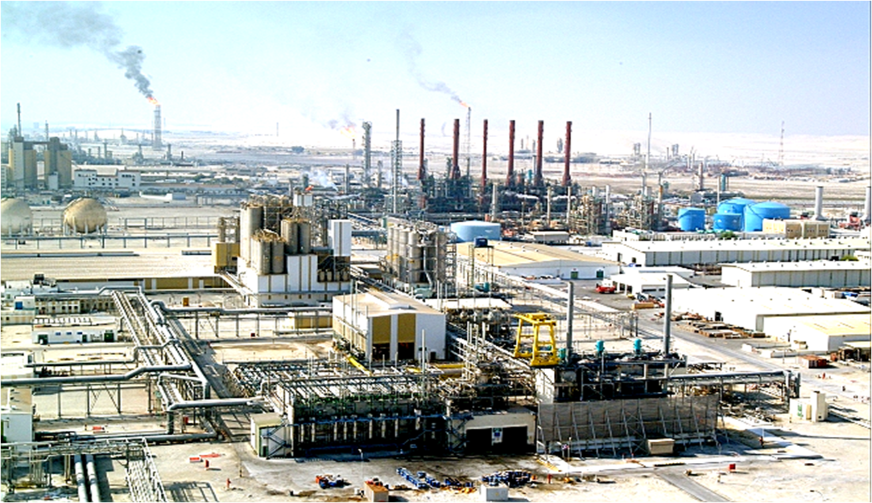
QAPCO ======= Mesaieed

Slide 29
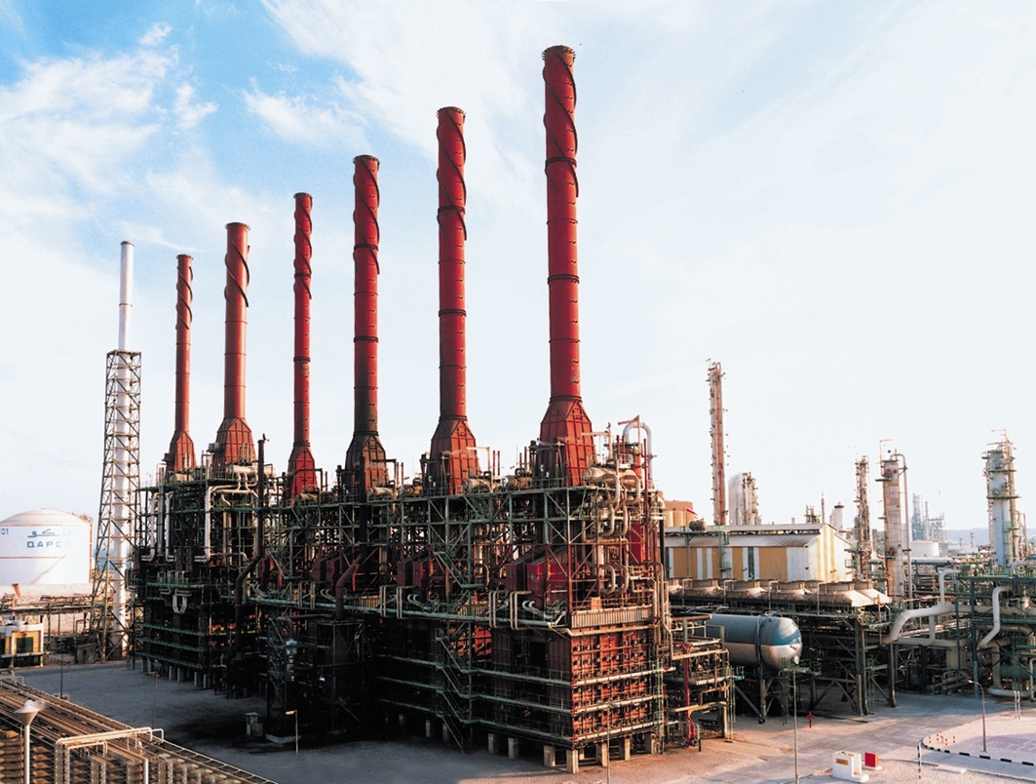
Ethylene Plant

Slide 30
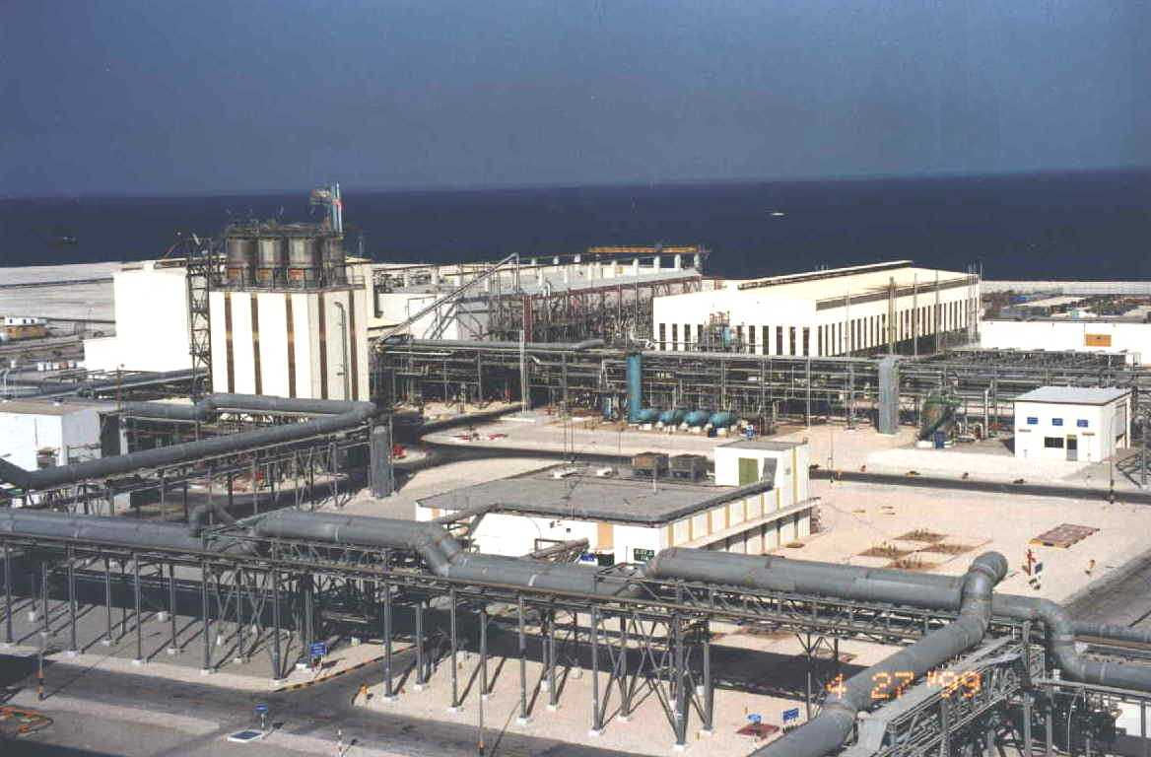
Polyethylene Plant

Slide 31
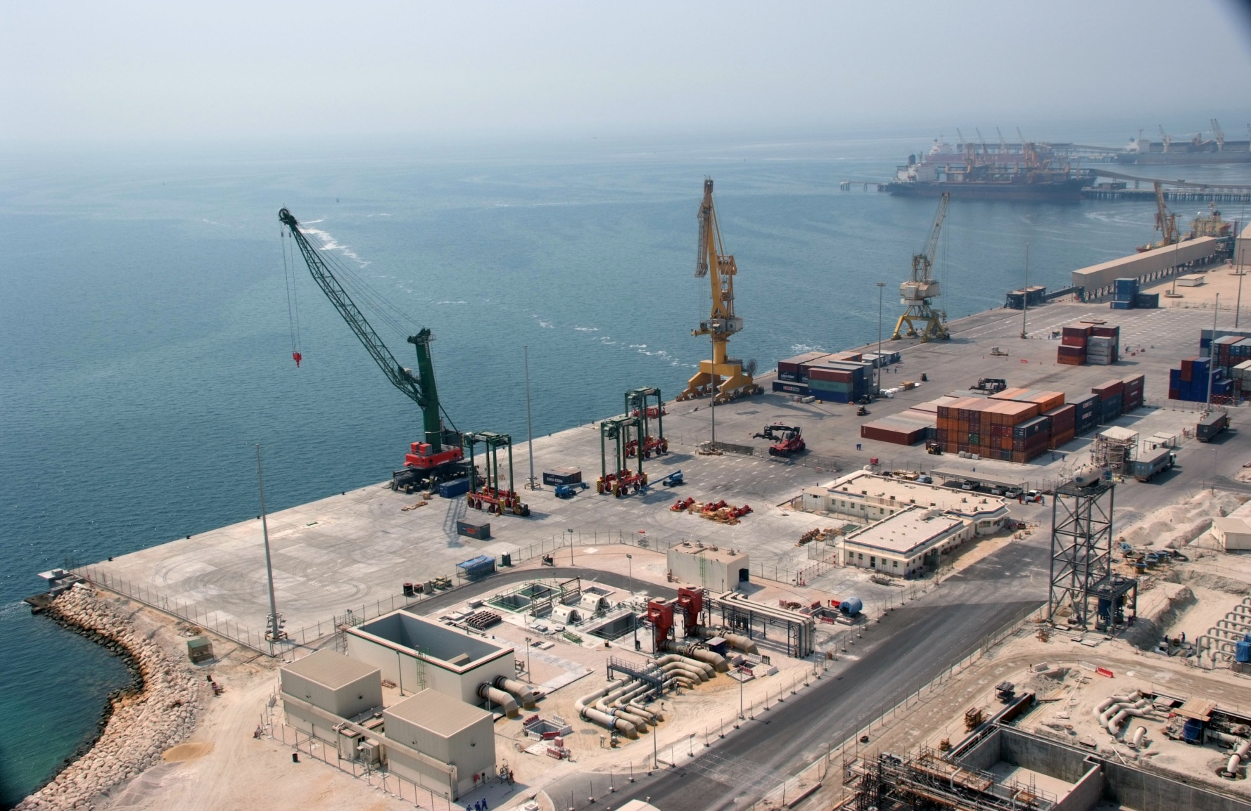
Jetty

Slide 32
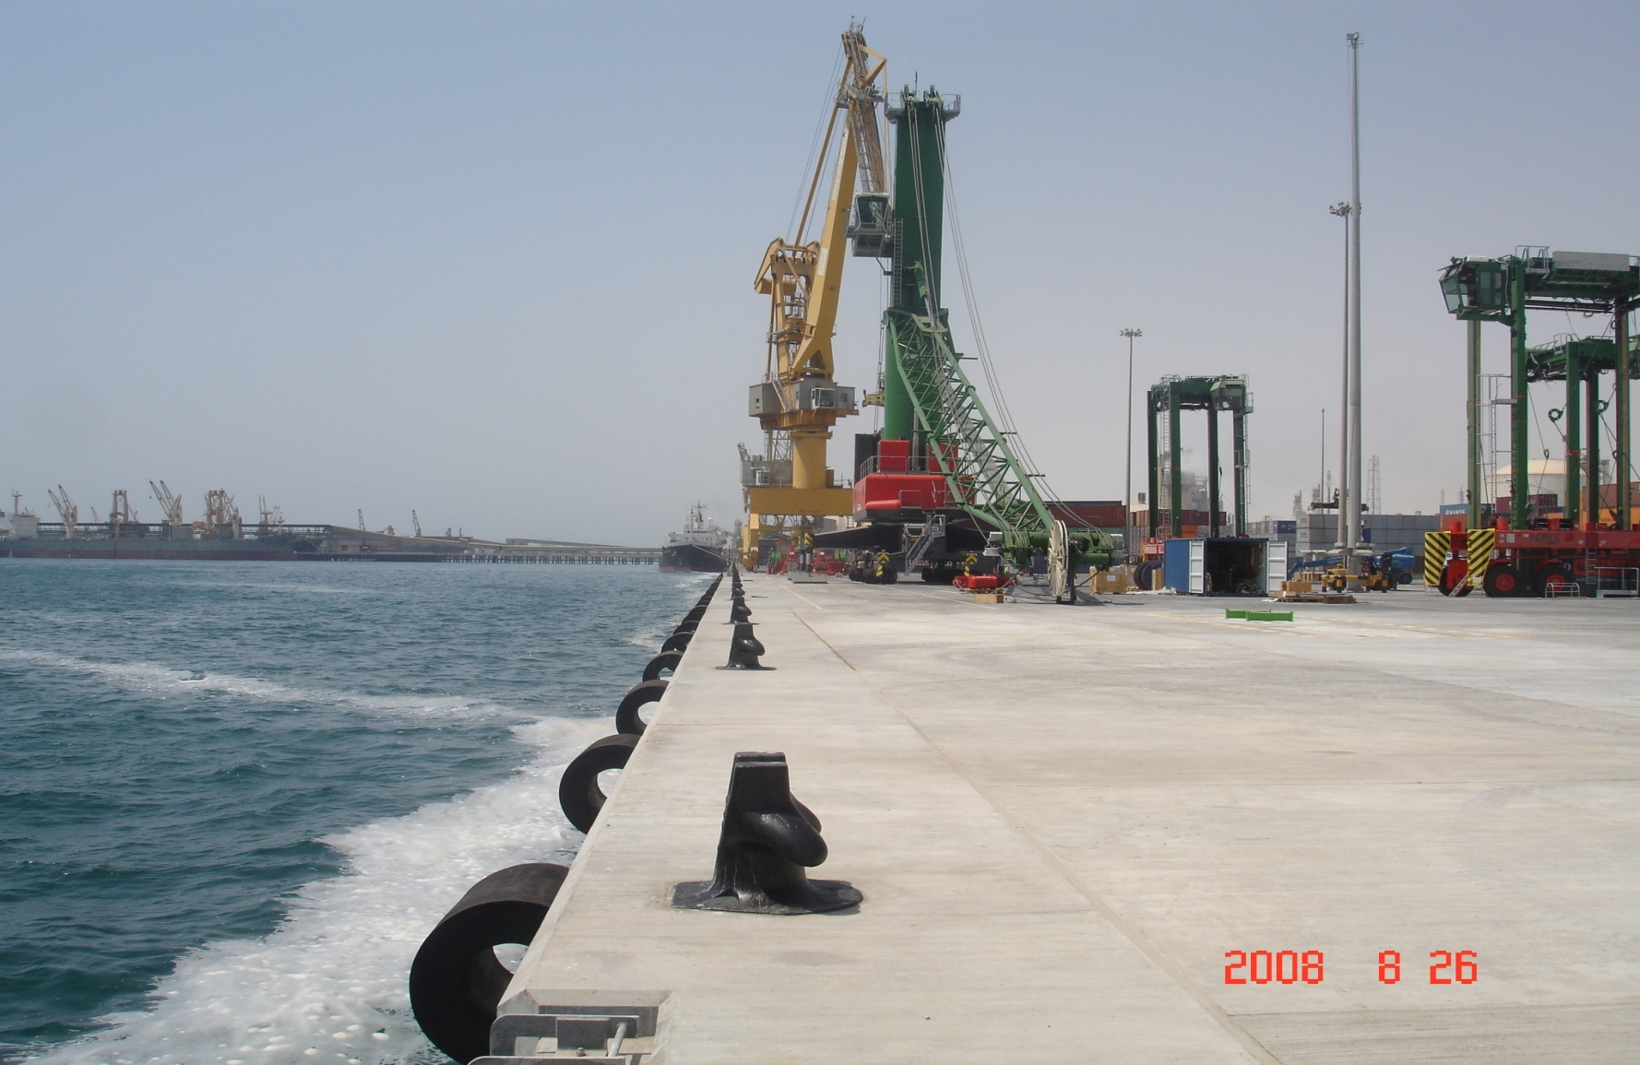
Jetty

Slide 33
Disclaimer & Trade marks
The statements in this presentation relating to matters that are not historical facts are forward-looking statements. These forward-looking statements are based upon assumptions of management which are believed to be reasonable at the time made, and are subject to significant risks and uncertainties. Actual results could differ materially based on factors including, but not limited to, the ability to implement business strategies; availability, cost and price volatility of raw materials and utilities; supply/demand balances; industry production capacities and operating rates; uncertainties associated with the worldwide economies; legal, tax and environmental proceedings; cyclical nature of the chemical and refining industries; operating interruptions; current and potential governmental regulatory actions; terrorist acts; international political unrest; competitive products and pricing; technological developments; risks of doing business; access to capital markets; and other risk factors.
This presentation contains time sensitive information that is accurate only as of the time hereof. We undertake no obligation to update the information presented herein except to the extent required by law.
QAPCO & Qatofin logos are registered trade marks.

Slide 34

Thank You

