Slide 1
The Quest of the Gulf to be the Global Petrochemicals Industry’s Centre of Gravity
GOIC’s 12th Industrialist Conference
Doha - Qatar ; November 23, 2009
Presentation by :
Dr. Abdulwahab Al-Sadoun
Secretary General, GPCA
sadoun@gpca.org.ae

Slide 2
Agenda
Who are we?
GPCA’s Fourth Annual Forum
The GCC Petrochemicals & Chemicals Industry Landscape
Growth Dimensions & Global Position

Slide 3
Who are we?
GPCA is a non-profit regional assocation launced in 2006 to represt the common interests of the Petrochemicals & Chemicals producers in the Gulf Region.
GPCA‘s Mission: To advance the Petrochemical and Chemical industry in the Gulf through fostering open exchange among members and with stakholders, developing relvant knowledge base, and supporting the industry in meeting its sustainable development objectives.
GPCA‘s Objectives:
Facilitating communication and knowledge sharing among members and between members and industry stakeholders
Serving as the voice of the industry and advocating the common industry positions
Promoting excellence in industry operations and meeting sustainable development objectives through the use of initiatives such as Responsible Care
Establishing GPCA as the main source for highly relevant industry data and perspectives
Fostering excellent relationships with regional communities and with fellow global industry associations
Notes:
3

Slide 4
Who are we?
GPCA‘s past focus on networking activities would be expanded to include other activities & services in three key areas:
Networking
Annual GPCA Forum
Annual Mini-Forums for various working committees
Advocacy
Advocating the common interest of the Gulf petrochemical/ chemical industry
Industry Reputation Programs & Responsible Care
“Think-Tank”
Providing relevant data, insights and perspectives on the chemical industry in the Gulf
Regularly identifying and publishing future trends / themes
Notes:
1
4

Slide 5
Who are we?
GPCA membership currently stand at over 140 with a diverse mix of regional and international players
Full Members ; Large regional producers with production capacities in access of 100 KTPA (e.g. Sabic, Equate, Tasnee, Qapco, QVC, QP, Sipchem, PIC, Saudi Aramco, Borouge, OPP, Oman Methanol, .. etc
Associate Members ; Wide spectrum of companies including:
Service Companies (Shipping & logistic, EPC Contractors, etc.
Business Partners (e.g. consultancy firms, chemicals traders,
International Producers (global chemical companies, e.g. ExxonMobil, Total, Nova, BASF, Dow Chemicals, Sinopec, ..etc
Gulf Producers (smaller Gulf producers e.g. Astra,
GPCA members by category
(November 2009)
Business Partner (40)
Service Companies
( 47 )
Total = 141
Intl. producers
( 20 )
Gulf Producers
( 3 )
Full members (31)

Slide 6
Who are we?
We made remarkable strides in expanding our membership over the past 3 years ..
GPCA members and growth (2006-to-date)
Tripling the Members since March 2006
Attrition rate so far: less than 2% p.a.
Membership growth target: 10-15% p.a.
Net growth by October 31, 2009 of 10% p.a.
+16% *
+20%
+71%
* By end October 2009

Slide 7
How are we structured?
GPCA‘s organization structure gives more focus on tasks with higher accountability and transparency
General Assembly
Board of Directors
Auditor / Finance Task Force
Working Committees
Executive Committee
Human Resources
Responsible Care
Supply Chain
Secretary General
Plastics
Exec. Secretary
Advocacy
Committees & Global Affair
Communication &
Marketing
Admin & Finance
Members Relations
Research & Studies
Fertilizers
Active
To be activated by 2010
Information/Media Relation
Convention Services
IT & Infor-mation

Slide 8
How are we structured? the Board and the Executive Committee
GPCA‘s Board of Directors is composed of 14 Senior Executives elected from the “Full Members Companies“ , providing active, visible and efective leadership for GPCA
Mr. Mohamed Al-Mady
Executive Committee
CEO, SABIC
Mr. Hamad Al-Terkait
Mr. Abdul Aziz Al-Hajri
Mr. Hamad Al-Nuaimi
CEO, Equate
CEO, Borouge
GM, QVC
Dr. Moayyed Al-Qurtas
Dr. Mohammed Al Mulla
CEO, Tasnee
GM, QAPCO
Mr. Abdulrahman Jawahery
Ms. Maha Mulla Husain
GM, GPIC
CEO, PIC
Mr. Ahmed Al-Ohali
Mr. Marwan Nusair
Mr. Zaid Labban
CEO, SIPCHEM
CEO, Alujain
CEO, Petro Rabigh
Mr. Mohmmed Al-Azdi
Mr. Khalifa Al-Suwaidi
Mr. Ali Al-Sidiky
CEO, ChemWEyaat
GM, QAFCO
GM, QP

Slide 9
Agenda
Who are we?
GPCA’s Fourth Annual Forum
The GCC Petrochemicals & Chemicals Industry Landscape
Growth Dimensions

Slide 10
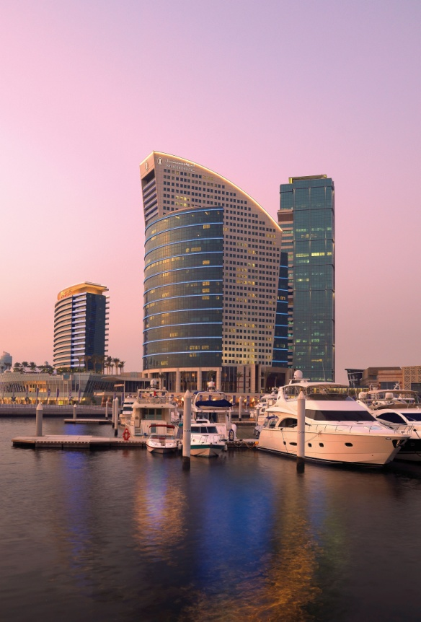
GPCA‘s Annual Forum
GPCA‘s Annual Forum is the flagship in the Petrochemical Conferences, on a regional & global levels
Forum‘s theme : Breaking through the Crisis to Pursue Sustainable Growth
Date & Venue: December 8-10, 2009; InterContinental Dubai Festival City, Dubai
Excellent Line of Speakers, including:
H.E. Ali Al-Naimi, Minister of Petroleum and Mineral Resources, Saudi Arabia
H.E. Rasheed Al Meraj, Governor of the Central Bank of Bahrain
Mohamed H. Al-Mady, Chairman, GPCA; Vice Chairman and CEO, SABIC
Stephen Pryor, President, ExxonMobil Chemical
Brad Bourland, Chief Economist, Jadwa Investments
Greg Garland, President & CEO, Chevron Phillips
Klaus Engel, Chairman, Evonik Industries AG
Paul A. Laudicina, Chairman, A.T. Kearney
Mark Garrett, CEO, Borealis
Prof. Vijay Govindarajan, Director, Tuck School of Business , USA
Cal Dooly, President American Chemistry Council

Slide 11
GPCA‘s Annual Forum
Topics/Themes to be discussed include:
How to Sustain Success in a Downturn with a Consistent Business Strategy ?
Cost-Cutting as Value Creation in the midst of an Economic Crisis
The Economic Crisis and Its Impact on the Mideast Chemical Industry
Financing Opportunities and Risks for Petrochemical and Energy Projects
Building a Viable Mideast Position to Pursue Sustainable Growth
How to Prepare to Emerge from the Downturn
Building a Global Presence from the Mideast
In 2008, 50% of delegates from GCC region and the balance are fromEU, USA, Asia overseas.
Register at www.gpca.org.ae/forum

Slide 12
Agenda
Who are we?
GPCA’s Fourth Annual Forum
The GCC Petrochemicals & Chemicals Industry’s Landscape
Growth Dimensions & Global Position

Slide 13
The Industry Landscape
The GCC Petrochemicals & Chemicals Industry is currently focusing on commodity chemicals with Saudi Arabia having the lion production share
GCC Petrochemicals & Chemicals Output Break-down,
By Country
By Product Category
Kuwait
Saudi Arabia
Fertilizers
(27%)
Oman
Basic Petchem
(40%)
Total
62.7 MTPA
Qatar
Abu Dhabi (4.0%)
Polymers
(13%)
Bahrain
(2.0%)
Intermediates
(20%)
Source: MEED, 2009

Slide 14
The Industry Landscape
The Industry in the Gulf is feedstock-driven ... With type of Feedstock available influencing the volume and type of building blocks produced and subsequently determining the Industry’s products portfolio.
Evolution of the Petrochemical Industry in the GCC States
Phase I
Phase II
Phase III
Associated Gas (C1 & C2)
Mixed
Feedstock
Refinery Integration
Development phase
1981-1994
1994 – to date
2008 onwards
Commodity petrochemicals (primarily PE & Glycols & MeOH)
More value chain petrochemicals added (e.g. PP, Polyester)
New set of value chains (e.g. Acrylics, Elastomers, Rubber, Engineering Plastics)

Slide 15
The Industry’s Growth Dimension
Key milestones in the Development of the Petrochemical & Fertilizers Industries in the Six Gulf States include:
1964
1973
1980
2005
KCFC (PIC)
Ammonia Plant
QAFCO
Ammonia/Urea
FERTIL
Ammonia/Urea
OMIFCO
Ammonia/Urea
Fertilizer Industry
1969
1979
SAFCO/Sabic
Ammonia/Urea
GPIC
Ammonia/Urea
1981
1985
1997
2005
QPCO
PE Plant
GPIC
MeOH Plant
Equate
PE/EG Plant
Oman
MeOH Plant
Petrochemicals Industry
1983
2002
Sabic/Arazia
MeOH Plant
Borouge
PE Plant
15
Notes:
15

Slide 16
The Industry’s Growth Dimension
Since the early production in the early 1980s, the petrochemical & chemicals industry in the GCC States maintained a consistent & exponential growth pattern
GCC Petrochemical & Chemicals Capacities (1985-2015)
Actual
Projected
CAGR = 12.0%
16
Notes:
16

Slide 17
The Industry’s Growth Dimension
The industry is sustaining its aggressive growth pattern in the short to mid-term future as demonstrated by the massive petrochemicals & chemicals capacity build-up is in the pipeline across the GCC region ..
Million Tons/yr
Current Capacities
(end 2008)
Capacities
under construction
Future Capacities
(2015)
+
=
Total GCC | 62.75 | 53.4 | 116.15

Slide 18
Future GCC Global Position
The GCC’s position in the global commodity petrochemical and chemicals industry is large and will be growing rapidly over the next decade
2008
2015
GCC Output = 62.7 MM Tons
Global Output = 550 MM Tons
GCC Output = 116.1 MM Tons
Global Output = 720 MM Tons
Source : MEED, SRI, 2009

Slide 19
The Industry‘s Growth Dimesnsion
In addition to the massive capacity addition, the Industry is moving towards a more diversified product portfolio, stimulating ample opportunities for developing downstream industries
Diversification Drive in the GCC Petrochemicals Industry
Current GCC Portfolio
New GCC Portfolio
Differentiated
commodities
Performance
Polymers
Technical
chemicals
Polyethylene
Polypropylene
Polystyrene
Basic chemicals
Polycarbonate
Synthetic Rubber
Polyacetal resins
Nylon
ABS
Acrylics
MMA/PMMA
MDI
Polyols
Carbon Fibre
Carbon Black
Catalysts
Olefins
Aromatics
Ammonia
Methanol
Forward commodities
Ethylene glycol
Styrene
PTA
MTBE
Increasing Value and Differentiation
Notes:
The Kingdom has many advantages, On raw material
For many years we have been putting the building blocks to support down stream industries, by growing the petrochemical sector, steel production and recently the aluminium industry with Maaden smelter project.
In the petrochemical arena,
the Kingdom is expanding its portfolio by producing performance and technical chemicals ………….. that are strategic inputs to the Cluster industries.
As an example, the production of
synthetic rubber and carbon black
will support competitiveness of tire manufacturing in the Kingdom.
…….and this is not all…...

Slide 20
Thank you !
Thank You !
www.gpca.org.ae

