Slide 1

GCC
SUBCONTRACTING PROGRAMME
Notes:
Good Morning, ladies and gentlemen!
It is a great honor for me to be here at the 12th Industrialist Conference and address such distinguished audience.

Slide 2
Agenda
Background & History of GOIC
GOIC SPX Programs
Activities
Conclusion
Notes:
In today’s presentation we will understand the importance of GCC Subcontracting Program' - a promotional program that must be one of the most challenging to address in GCC Industry today. Especially the relationship between buyer and supplier. This presentation begins with brief background about GOIC, SPX program its activities..

Slide 3
Background & History of GOIC
  Founded in 1976
  A knowledge-hub and an industrial investment promotion catalyst for the sole purpose of industrial diversification and development within the GCC.
  GOIC has played an influential role in identifying and introducing new industries to the region.
  Its recommendations shaped public policies particularly the unified common industrial strategy that was adopted by all GCC member states.
Notes:
The Background & History of GOIC - Gulf Organization for Industrial Consultancy was established in the year 1976, it is a …………. Read the slide

Slide 4
GOIC SPX Program
GOIC has developed particular and specialized Programs intended to facilitate the transfer of knowledge and the decision making processes.
A Program initiated with the assistance of the United Nations Industrial Development Organization (UNIDO) to work as a match-making mechanism on industrial relations and creation of business contacts between contractors and sub-contractors, usually Small and Medium sized Enterprises (SMEs).
  GSPX will be a road map to promote Small & Medium Enterprises in GCC nation.
Notes:
Lack of development in industrial subcontracting activity in GCC is the primary reason why GOIC SPX program came into operational. The GOIC SPX – Subcontracting and Partnership Exchange program has developed…..read the slide

Slide 5
SPX – Subcontracting & Partnership Exchange
Definition :
“An SPX is a centre for technical information, promotion and the matching of capacities, processes and production or industrial service specialities, in the form of an autonomous structure whose basic purpose is to help bring together enquiries for and offers of subcontracting work and outsourcing.”
Notes:
The basic definition for SPX – is …………. Read the slide

Slide 6
SPX – Sub contracting and partnership Exchange
SUPPLIER
BUYER
SUB CONTRACTING
DEVELOPMENT FINANCE
INVESTORS
PARTNERSHIP
Types of contracting
- Capacity utilization &
Specialization
Notes:
To explain further about SPX - There are two elements in SPX 1st SUBCONTRACTING and 2nd PARTNERSHIP. The Subcontracting is a relationship between Buyer and Supplier – namely buyers like QP, BAPCO, ADNOC,ARAMCO and supplier are usually SMEs. The focus will be on capacity utilization among Suppliers, provide business matchmaking, improve competitiveness etc.,. …………….. The 2nd element, partnership is a relationship between Investors and Service provider like Banks, technology centre and consultant etc., which will lean to make decision on New industrial investment, Industrial expansion or Diversification, Technology provider & seekers, Quality consultant etc., the effective linkage among all the stake holders is prime objective of this program. It is surprising to know that GCC suppliers share in industrial market is less than 10%. SPX will play a major role in increasing this market share.

Slide 7
OBJECTIVES
Establish GCC regional Subcontracting Database
Support the GCC industrial linkages
Provide Industrial Matchmaking opportunity
Consultations – Technical, Quality, Investment, Capacity building for SMEs
Promotion for industrial cooperation & partnership
Enhance the productivity and competitiveness large & SMEs
Maintain computerized data bank with detailed information of companies
Improve competitiveness
Provide Web based Online application for matchmaking
Notes:
The Objectives of SPX program are …………. Read the slide

Slide 8
Activities of SPX
Survey
Data Coding, Entry
Receive enquires
Match
making
Follow up
Update profile
Promotional programs
SPX
activities
Notes:
The core activity of SPX begins with SURVEY each company will be visited by expert or qualified Engineer to verify the correctness of company information, latter data entry and coding exercise will be carried out at SPX centre.
After carefully analyzing the questionnaire, demand based promotional programs will be organized like ISO 9000 consultancy, Management Training, Technical training etc.,
During the process enquires will be received from buyer and suitable suppliers will be identified which is known as matchmaking, of course SPX will do follow up and members profile will be updated regularly to get accurate information.

Slide 9
Services to members
B2B meet
B2B meet with selected Buyer
One to one meet with suppliers
Need based programs
Quality training & Technical know how
World class manufacturing practice
Consortium
To group in line with assemblies / sub assemblies
Process oriented group
Capacity Utilization
idle capacity
Specialized activity
Business information
Provide filtered tender information
Dynamic web portal to post the enquiries
Notes:
The core services for members are Business-2-Business meet…………… need based programs………, creating consortium for cost effectiveness, effective utilization of all the resources and provide update and latest business information to members.

Slide 10
SPX Performance Criteria
No. of match-making
No. of sectors covered
No. of promotional events/fairs/meetings
No. of companies registered
Accurate member database
Financial sustainability of the SPX
Notes:
The SPX activities are measured by the following …………. Read the slide

Slide 11
GOIC SPX Members profile
Total No of products
covered : 2176 Nos.
Currently 667 suppliers
Target : 1500 suppliers by 2010.
Notes:
This is chart indicates the sector-wise distribution of active members registered with SPX, As on date we have 667 members registered who out put together manufacture around 2176 variety of products. We expect to increase members from 667 to 1500 by end of 2010.

Slide 12
The Database
GOIC SPX Web portal
GOIC IMI Web portal
Industrial Market Intelligence Database
Outsourcing software
Buyer Database
Subcontracting information
Foreign Trade Database
Socio-Economic Database
Investment opportunities Database
Experts Database
Supplier database
Subcontracting Database
Matchmaking between buyer & supplier
Exclusive regional web based service for SPX members
Gulf Industrial Database
www.goic.org.qa/SPX.htm
collection of GSPX members data and search tool
www.imi.goic.org.qa
collection of GCC comprehensive and valuable data
collection of regional SPX members database in GCC
Notes:
We adopted latest IT tool as a platform to maintain the database. Such as dynamic web based portal and outsourcing software.
1. Exclusive regional web based service for SPX members, which includes search by Company name
Company address, Contact names, quality, employee, Financial information, Sector of activity
Product and services, Subcontracting product, Manufacturing operations, Machine lists, Test and control equipments apart from this we have Industrial Market Intelligence website which provides information, which is explained in Next slide…
2. IMI website is a collection of GCC comprehensive and valuable data through Industrial Market Intelligence. IMI is useful for industrial partnership between Investors and development banks.
3. Outsourcing software is meant for industrial matchmaking to identify suppliers and collection of SPX members company profile in GCC

Slide 13
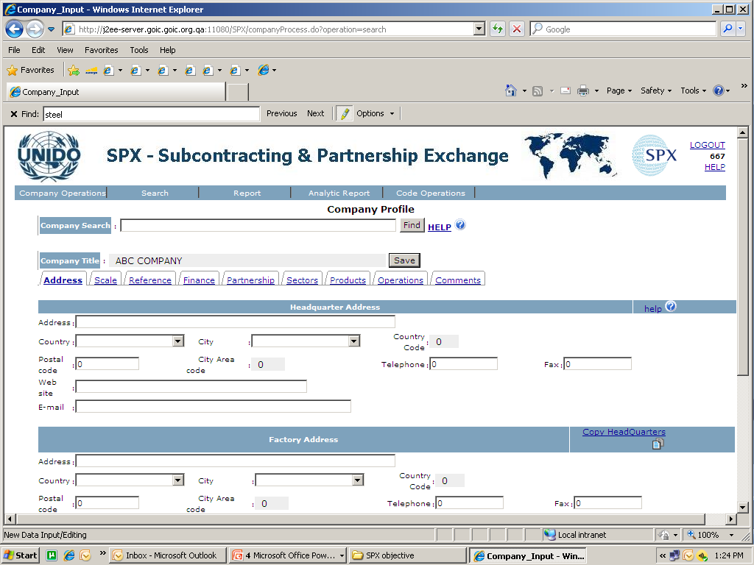
Outsourcing software
Outsourcing
software to maintain member database & search Companies
Notes:
The Outsourcing software is used to maintain company profiles which are classified according to international coding like ISIC: The International Standard of Industrial Classification of All Economic Activities- UN Classification, UNSPS: United Nations Standard Products and Services Codes, HS Code: Harmonized Code. EEC A and EEC B Codes: subcontracting product and manufacturing operations as a members database.
Powerful Search to provide accurate information on: Company name; Company address ; Contact names ; Other information (quality, employee, etc.) ; Financial information ; Sector of activity; Product and services ; Subcontracting product ; Manufacturing operations; Machine lists ; Test and control equipments

Slide 14
GOIC IMI Database
1. Gulf Industrial Database
More than 4000 products
Over 12000 Manufacturing Companies
2. Foreign Trade Database
GCC Imports, Exports
Source of Origin and Volume of Trade between GCC and the World
3. Socio-Economic Database
Industry
Over 4000 Licensed Companies
Over 7000 commodities within 5 years timeframe
population
Foreign trade
Price index
Finance
National accounts
Health education
Caters to the needs of Investors and Industrialists for Industrial information, necessary for decision making on Investment and Marketing
Trade Volume (By Products)
Trade Volume (world wide)
Exchange Trade by Top
selected products
Contains over 400 statistical tables, covering all aspects of Socio-Economic indicators of GCC countries, includes:
Notes:
GOIC IMI Database consist various information on GCC such as 1…….. 2……… 3………. 4 & 5 next slide..

Slide 15
GOIC IMI Database
4. Investment opportunities Database
Engineering
Finance
Economic
Industry
5. Experts Database
Manpower
Product feature
Capacity
Capital investment
Market
Technology
Raw material
Name & Address
Field of specialization
Education & practical experience
Notes:
4. Investment opportunities Database
Providing reports on the investment opportunities profiles conducted by GOIC to promote industrial investments within GCC. These reports cover, and not limited to:
5. Experts Database
It is including information on experts within GCC. Covering many sectors such as: …….
Experts Database cover various information including : Name & address, Field of specialization
Education & practical experience

Slide 16
Benefit of Portal
Information obtained from the IMI / SPX Portal will help subscribers to:
Matchmaking between buyer and supplier
Conduct feasibility studies using accredited and updated data.
Identify the region’s top industrial investment opportunities
Target potential customers for marketing products and services.
Find the experts / consultants who can support their business
Bridge the gap between supplier and buyer
Notes:
As discussed in our earlier slides - Our portal will have customized search to benefit the end user.

Slide 17
SPX program benefits
INVESTORS/ DEVELOPMENT AGENTS
Identifying of potential partners.
SUPPLIER
Strengthens their position in the Supply Chain:
BUYER
Broaden their supplier-base
Understanding of the sectors activities.
Identifying Supply gaps and opportunities.
Strengthening the industrial linkages.
Increasing the manufacturing output
Identifying sector priorities
Capitalize on their strengths/Reduce their weaknesses.
Access to regional & international markets.
Powerful tool to understand your industry by global buyers
Assist in finding right Match for business promotion
Participating in upgrading their supplier
Reduce the lead time for supplier identification and selection
Ensuring high quality and reasonable prices
Notes:
There are several benefits to various stake holders, few of them are ………

Slide 18
CONCLUSIONS
GSPX will strengthen the suppliers position from regional to global supplier
GSPX Industrial corporation & partnership is the best move under market Globalization
Win-Win situation for Buyers, Suppliers, Investors & Development Agencies
A call for joining hands to further enhance our cooperation and partnership to fulfill the vision for GCC as World class supplier destination by 2020.
Notes:
Last but not the least……………………………. Read the slide.
With this I conclude my presentation. NEXT SLIDE

Slide 19

Eng . Hazem Al Anqar
Industrial Support Unit
Notes:
Thank you, and we wish that you would find the GCC program a useful resource for strengthening and enhancing your business.
To avail the service of SPX and for company registration please do contact GOIC SPX. ……….THANK YOU.

