Slide 1
EDC Strategy Leverages
Partnerships & Innovations
Eng. Ahmed AlQedrah,
Notes:
1

Slide 2
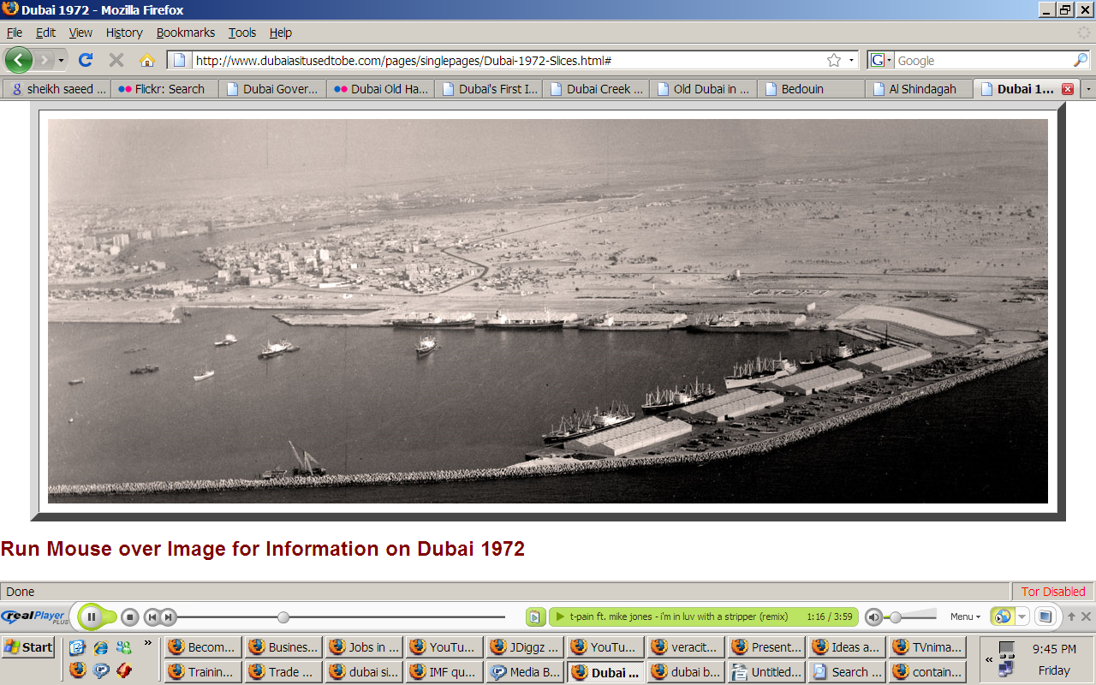
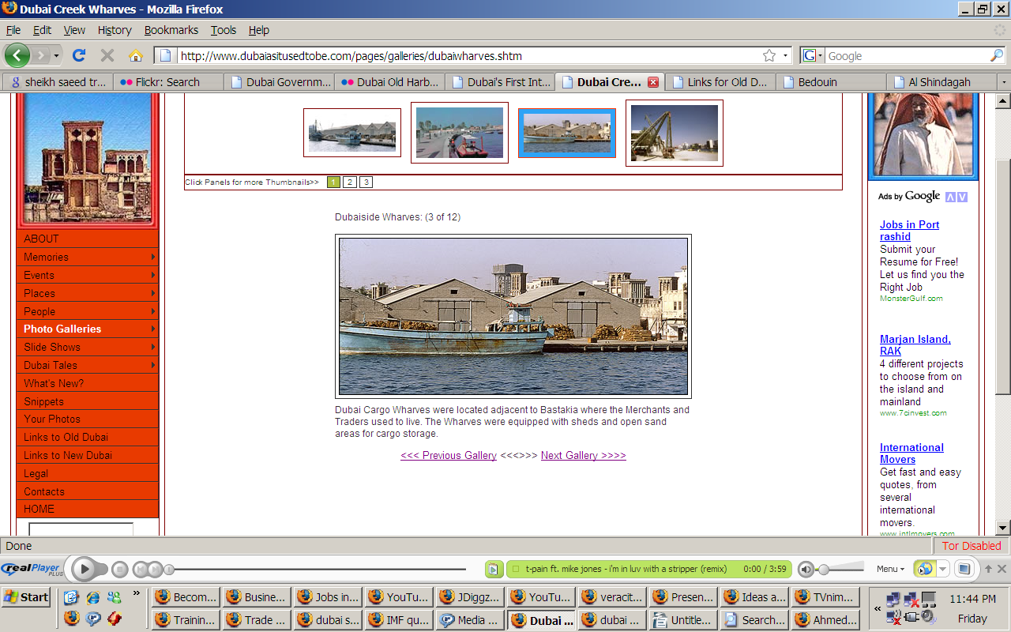
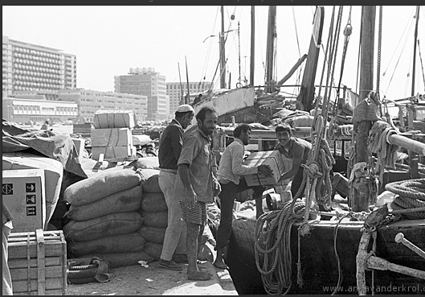
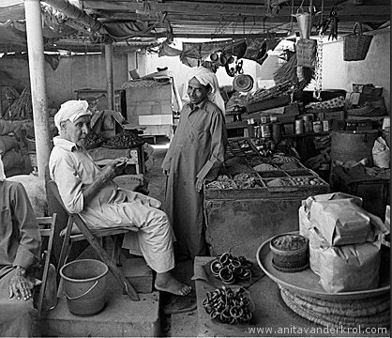
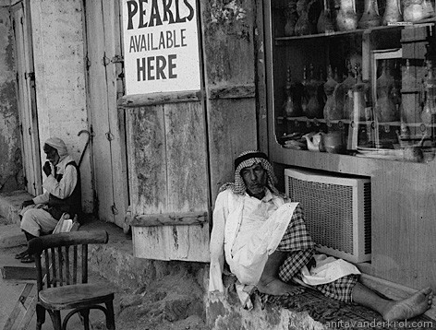
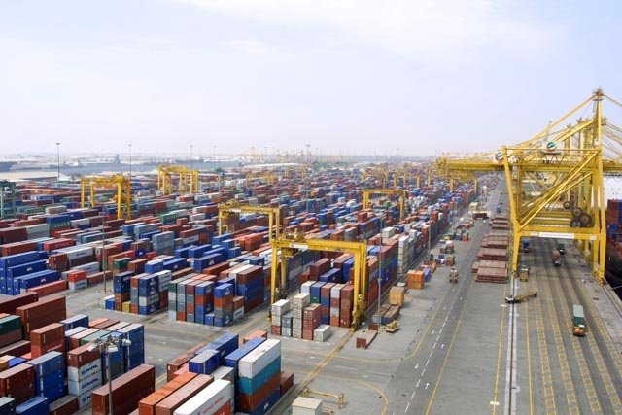
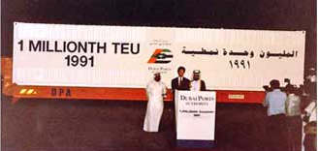
Notes:
3rd largest re-export hub in the world and 9th largest export hub in the world
A gateway to a US$150 billion market (ME and Africa)
A regional import market of roughly 1.4 billion population
A growing and an accessible market: some 30 Free Zones and 7 Industrial Parks
Manufacturing and export sectors with average growth of 20% and higher contribution to the GDP. Total export from Dubai was 36% higher than during the first quarter this year compared to last and 44% higher in the 2nd quarter compared to last.

Slide 3
Contents
(1) Dubai Strategic Plan
(2) EDC Strategies & Initiatives
(3) Export Performance
(4) Recent Trends
(5) Dubai SPX

Slide 4
  1/5 Dubai Strategic Plan

Slide 5
  Economic Vision of Dubai
Strategic Plan
(2007 – 2015)

Slide 6
Economic Development Strategic Goals
(1). Sector focus and development
(2). Productivity growth
(3). Human capital excellence
(4). Science, technology, and innovation capacity building
(5). Cost of living and doing business management
(6). Quality of life improvement
(7). Policy & institutional framework excellence
(8). Laws and regulations alignment

Slide 7
  2/5 EDC Strategies & Initiatives

Slide 8
EDC Vision and Mission
Our Vision
To be a world class export development agency through innovation
Our Mission
To empower and diversify Dubai's economic
growth by offering pioneering export services to
businesses

Slide 9
Measuring Effectiveness
To support the objectives and targets of the Dubai Strategic Plan 2015, our Key Performance Indicators are:
Grow the value of exports
Grow the number of new exporters
Grow the number of exporters entering new markets
Assist exporters to improve their business performance
Exporter satisfaction surveys

Slide 10
EDC Strategic Model
Information, financial assistance, credit insurance, etc
Partnerships with international TPOs
Integrated services and partnerships
Export Promotion
Export Development
Increase market shares in current markets
Penetrate new markets
Increase the number of exporters and upgrade their capabilities
Expand industrial base through attracting new investments
Increase value added
Diversify products

Slide 11

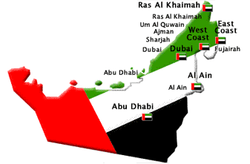
Linking Members and Buyers
Export Preparation
Identify and Prioritise
Export Facilitation
Develop Relationships
International Assistance
Link with
Members
Making Quality Linkages
Developing Relationships
Producing Value
Notes:
11

Slide 12
Target Products
Group A
Group B
Capacity Building with
Emphasis on Promotion
Promotion with
Emphasis on Capacity Building
Precious
Metals and Stones
Iron and Steel
Plastics
Printing and Paper
Aluminum
Ceramics
Furniture
Electrical Machinery
Processed Food
Mineral Fuels
and Oils
Notes:
12

Slide 13
Target Services
Aerospace
High-grade Composites
Maintenance
BPO
Data Analytics
Market Research
Consulting
Architectural Design
Information Technology
Designing
Internet Arabic Platforms
Mega Projects
Education
Continuing Education
Hospitality
E-government
E-government Platforms
Operational Models
Financial
Commodity Trading Platform
Islamic Finance
Media
Movie Production
Radio and Television
Shipping
Logistics
Re-export Systems
Notes:
13

Slide 14
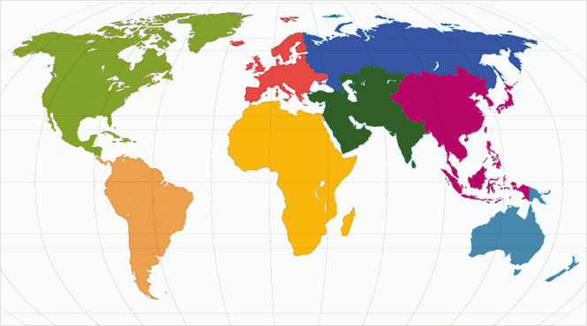
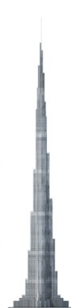
Phase 1Internatioal Offices Network
Germany
Saudi Arabia
India
Singapore
South Africa
Notes:
Phase 2 will include Australia, North America, South America, China, S. Korea and Russia.
14

Slide 15
EDC Services Model
Export Preparation
Information on Markets
Assistance Through Partners
Export Facilitation
Identify Buyers
International Assistance
Support Buyers
Facilitate missions
Assess Export Capability
Provide Export Opportunities
Participate in local events
Assist with Tenders
Facilitate investment partnership

Slide 16
Local & International Exhibitions
Career Fair
HISPACK
Aluminum Dubai
Big 5

Slide 17
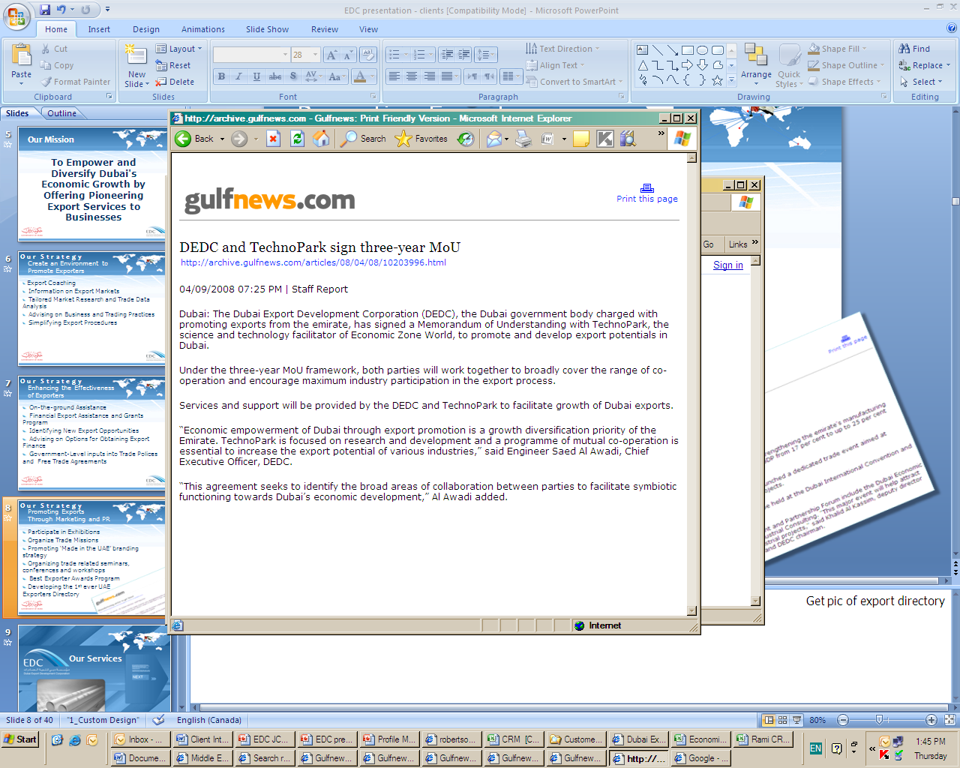
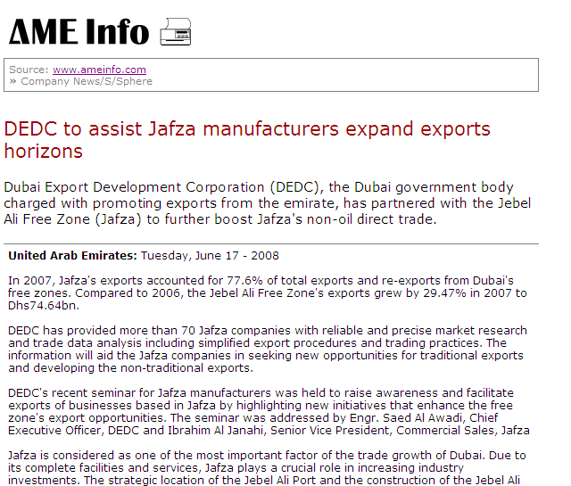

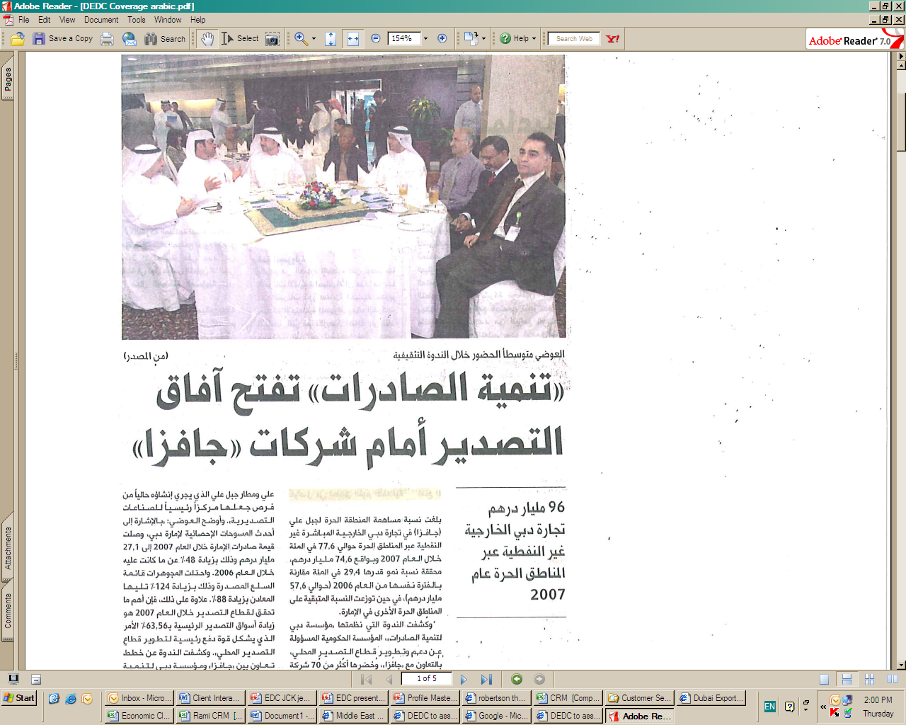
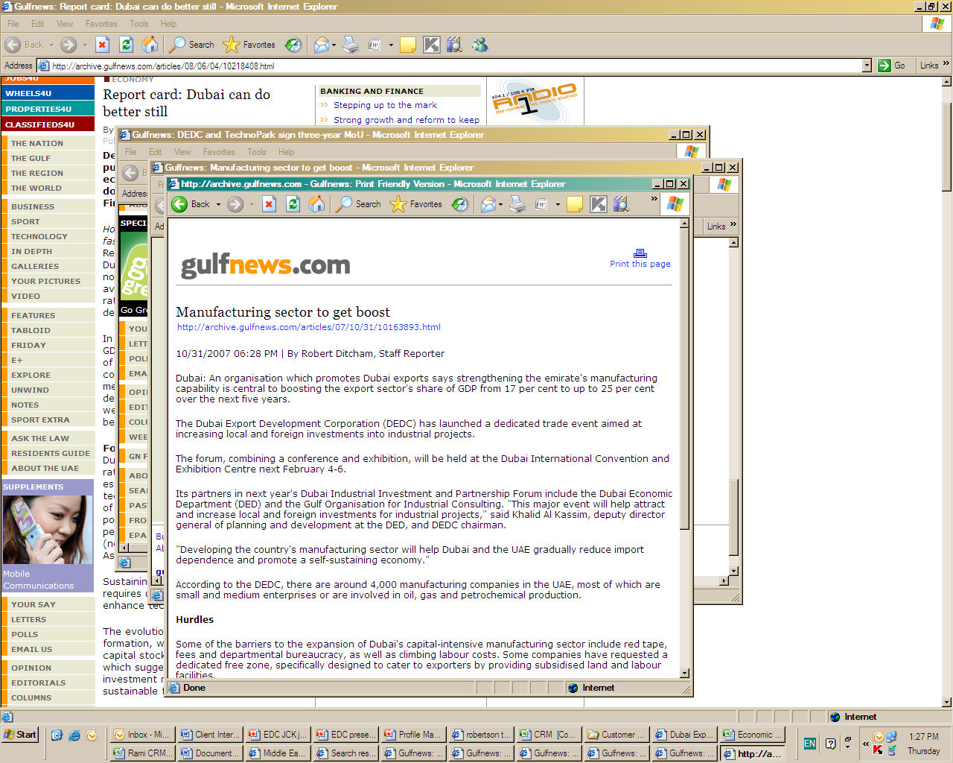

Partnerships
Strategic Partnerships
Agreements with government and private entities have been finalized with more in the pipeline – all aiming at promoting closer cooperation and facilitating exports.
TPO’s
Government departments
Regional & International Organizations
Business & Industrial Clusters

Slide 18
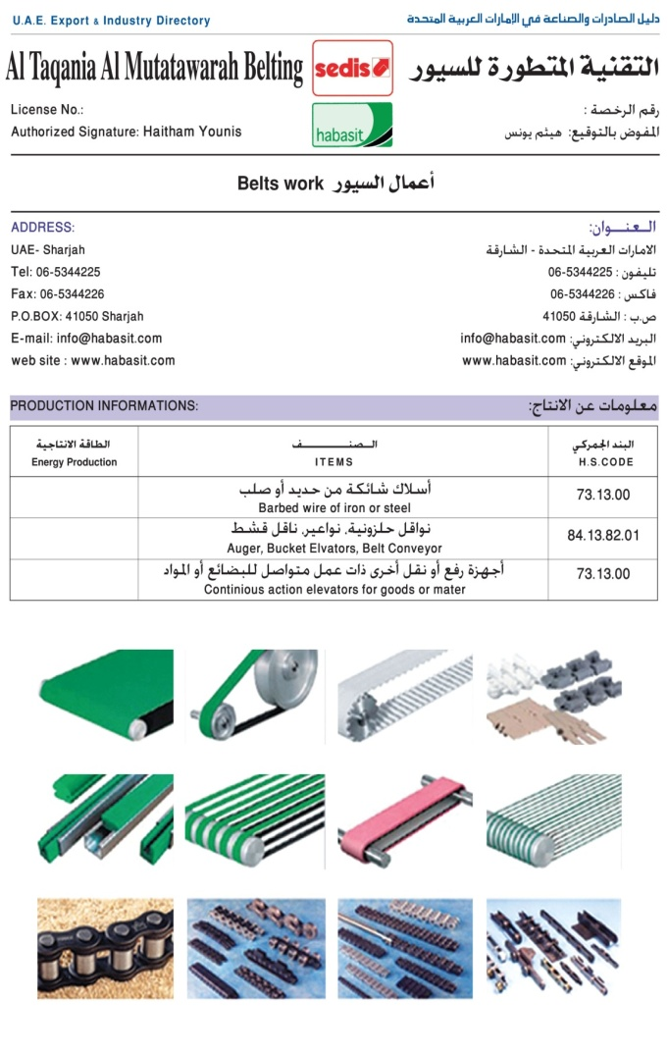
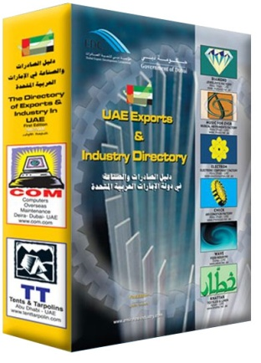
Exporter E- Directory a Matchmaking Platform
Exporter Directory
A database categorizing the key manufacturing and services sectors (around 6,000 establishments) in the UAE.
Information will be searchable by product, HS Code, and location (featuring a sophisticated GPS system). Will be ready by December in hard and soft copy format.
Please visit www.uaeexportdirectory.ae
The Directory complements and reinforces Dubai-SPX

Slide 19
  3/5 Export Performance

Slide 20
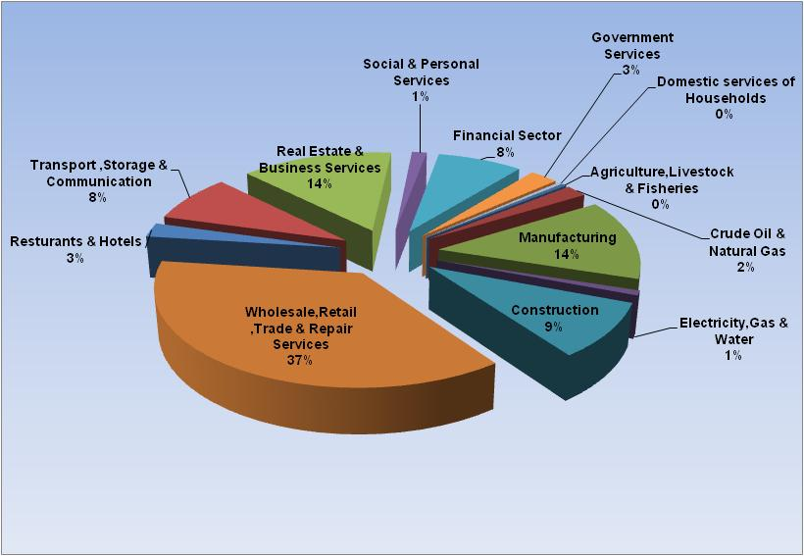
% Contribution of Economic Sectors to GDP - Dubai 2008

Slide 21




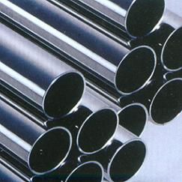

Dubai Direct – Trade Trends
Macro economic indicators
Growth % | 2006-2007 | 2007-2008
GDP | 18.4 | 14.4
Export | 48.3 | 57.5
Re-export | 28.5 | 27.8
*Figures are rounded off to one or two decimals as shown for each parameter.
Value: AED Billions
Source: Dubai Statistics Center

Slide 22
Exports Contribution to Dubai Economy

Slide 23
Exported Products 2008

Slide 24
Dubai - Export Markets

Slide 25
  4/5 Recent Trends Q1 2009 Versus Q1 2008

Slide 26
Dubai Direct Trade

Slide 27
Free Zone Trade

Slide 28
  5/5 Dubai-SPX

Slide 29
SPX Model -A Partnership Initiative
Dubai SPX
Response
Inquiry
Report
Inquiry
Inquiry
Response
Process of Matchmaking

Slide 30
Target Subcontracting sectors
Main Contractors
Plastics
Metal Fabrication
Packaging
Chemicals

Slide 31
Dubai SPX Achievements Milestones
Creation of SPX Database 2007-2008
DIIPF Matchmaking Event Feb 2008
Pre-Launch &Technical Verification
Launch Sponsored by EDC,GOIC and UNIDO June 2009

Slide 32
DIIPF an Important Milestone-Agenda of the event
Subcontracting & Partnership Exchange Workshop
Manufacturing Investment Opportunities Seminar
Pre Scheduled Bilateral Meetings between Main Contractors(Buyers) and Sub Contractors(Exporters)
Matchmaking & Business Deals
Exhibition

Slide 33
DIIPF Evaluation
65 B2B meetings were conducted
Satisfaction Rate 92%

Slide 34
Dubai SPX Launch June 2009
Dubai-SPX Launch
UNIDO Representative
GOIC Secretary General
UNIDO

Slide 35
Why Dubai SPX is Unique?
It achieves EDC’s two main objectives:
Building domestic industry capacity: through creating and enhancing interlinkage between industries
Increasing exports and expanding export destinations: through professional matchmaking between local suppliers and international buyers based on sound databases.

Slide 36
Why Dubai SPX is Unique?
It integrates with EDC Service Model and benefits from the following:
local & international exhibitions
networking and matchmaking events
Strategic partnership with TPO’s
Strategic Partnership with clusters e.g. JAFZA, DAFZA
Comprehensive databases e.g UAE Exporters Directory , Buyers Database.
Outward missions and outward missions.
Sharing of resources.
Attracting investments aimed at promoting exports.

Slide 37
Dubai SPX Future Programmes
Focus on Diversification of the Supplier Database
Initiate a programm to upgrade Local Suppliers capabilities to international Standards of multinational buyers
Globalize-Benchmark with world SPX’s and link with international Databases

Slide 38
THANK YOU
Eng. AlQedrah, Ahmed
+971 4 4298888
Notes:
38

